Slide 1
Week 6 Numerical Simulation of Foams Presentation
By Tony Hau

Slide 2
Objective of this presentation section
To explain the mathematics and peudocode behind the simulation of bubbles

Slide 3




Main reference: https://raw.githubusercontent.com/erleben/FOAM/master/doc/bondorf.17.master_thesis.pdf
Simulation of Two-Dimensional Dry Foam Using a Vertex Model

Slide 4
How to represent a bubble in simulation?
Delaunay triangulation and Voronoi diagram
Real bubble configuration → Voronoi diagram → called primary mesh
Fake bubble configuration → Delaunay triangulation → called dual mesh

Slide 5
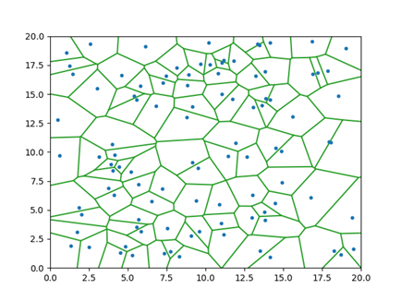
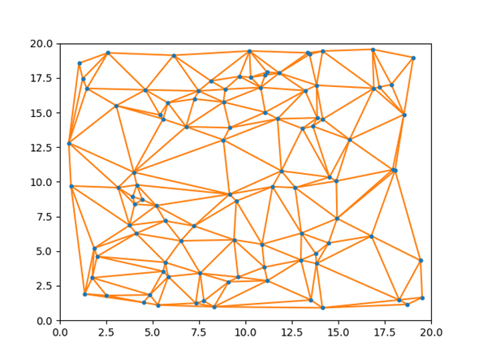
Information stored in a vertex
Voronoi Diagram
Properties of Delaunay Triangulation
In a real bubble configuration(Vornoi Diagram), each vertex of Delaunay diagram represents one bubble
Therefore, can store information about a bubble in the vertex of Delaunay Triangulation(dual mesh)
vertex
Delaunay Triangulation
face
edges
Triangle mesh

Slide 6
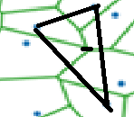
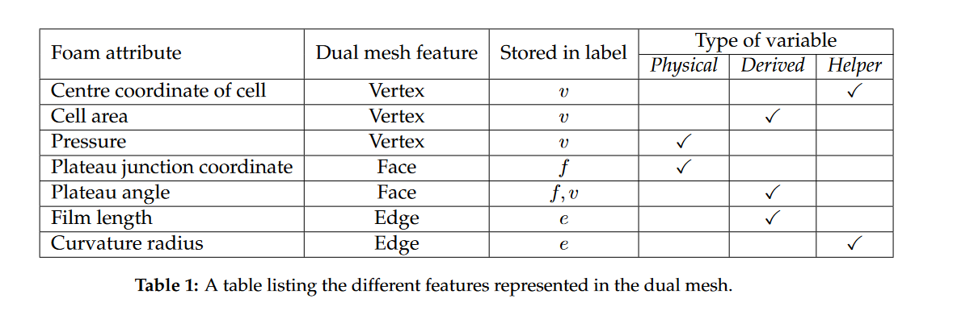
Information stored in a vertex
Needs two parameters, one is the v parameter(vertex)
Bubble property
Where is it represented in a Delaunay Triangulation?

Slide 7
Initialization and operations in the simulation
Pressure is initialized as uniform within the bubbles, and lower outside the bubbles → Pressure difference → Not in equilibrium → cells start to rearrange themselves
Pressure is relative as pressure difference is the only concern

Slide 8
Initialization and operations in the simulation
However, in this simulation we allow T1 operation if the separation is below certain minimum threshold. Reason: moving below the threshold h would increase the energy, and thus a flip is performed.
T1 operation
T1:
Meaning: if the change in the next step is smaller than the separation between two bubbles (vertex)
T1 representation in dual mesh

Slide 9
Initialization and operations in the simulation
T2 operation: removal of a bubble if it is below a certain user-defined area threshold

Slide 10
Physical descriptors

Slide 11
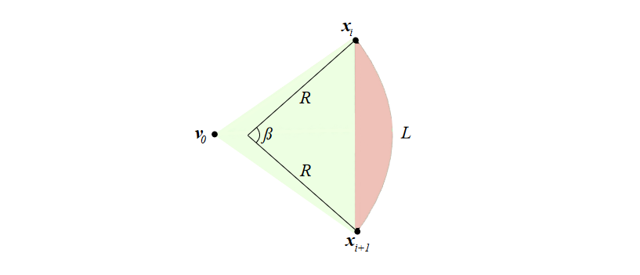
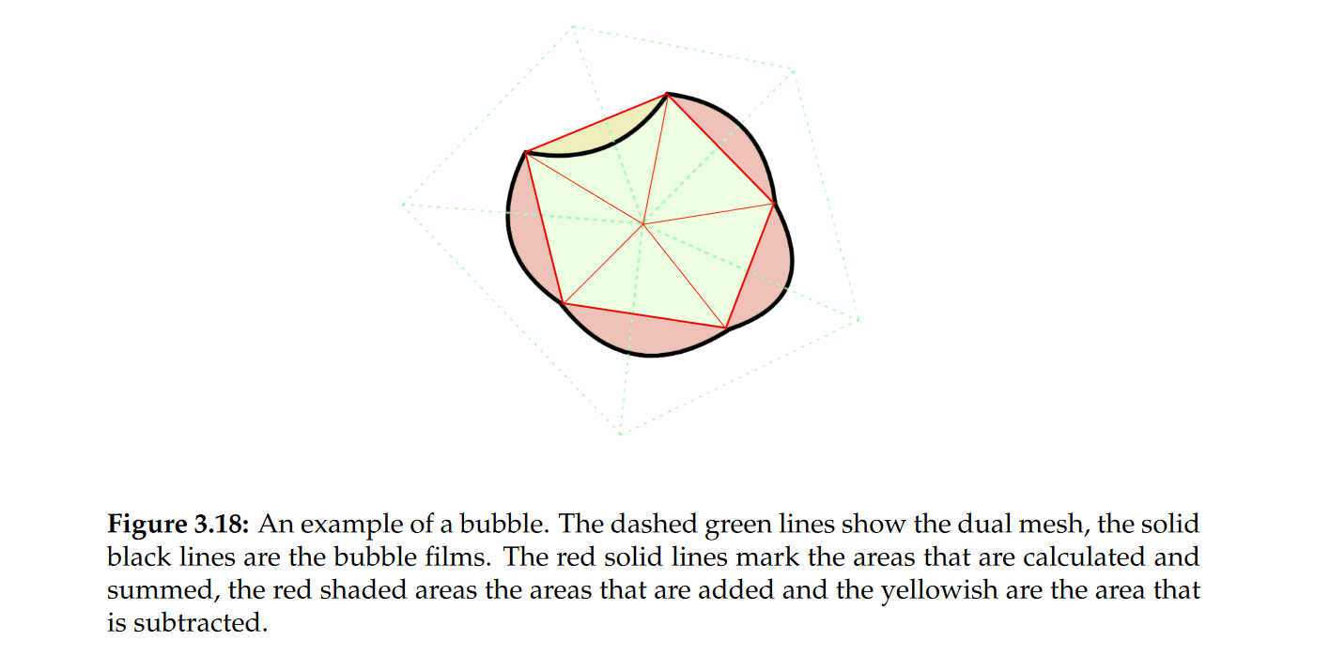
Physical descriptors – Bubble area
Bubble film bulged outwards due to pressure difference
Voronoi

Slide 12
Physical descriptors – Film lengths

Slide 13
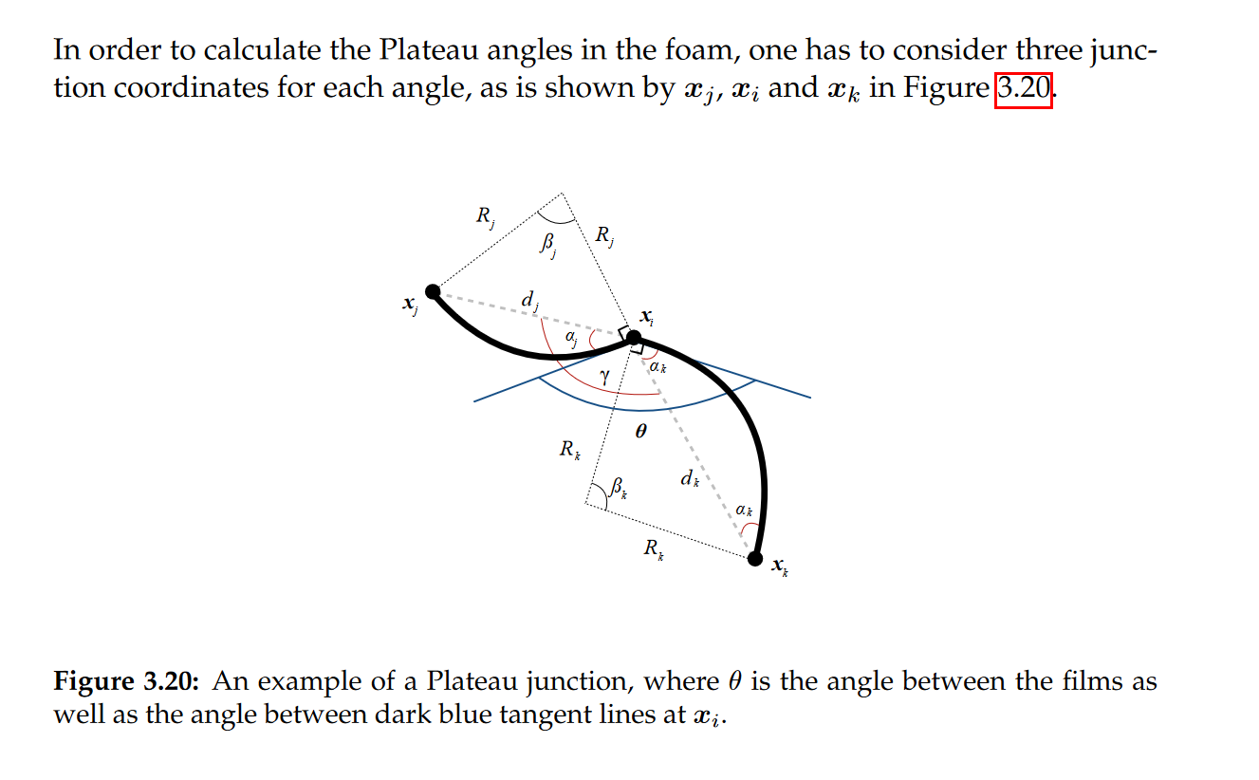
Physical descriptors – Plateau’s angle

Slide 14
Finding the configuration for equilibrium state
area change depends on pressure difference

Slide 15
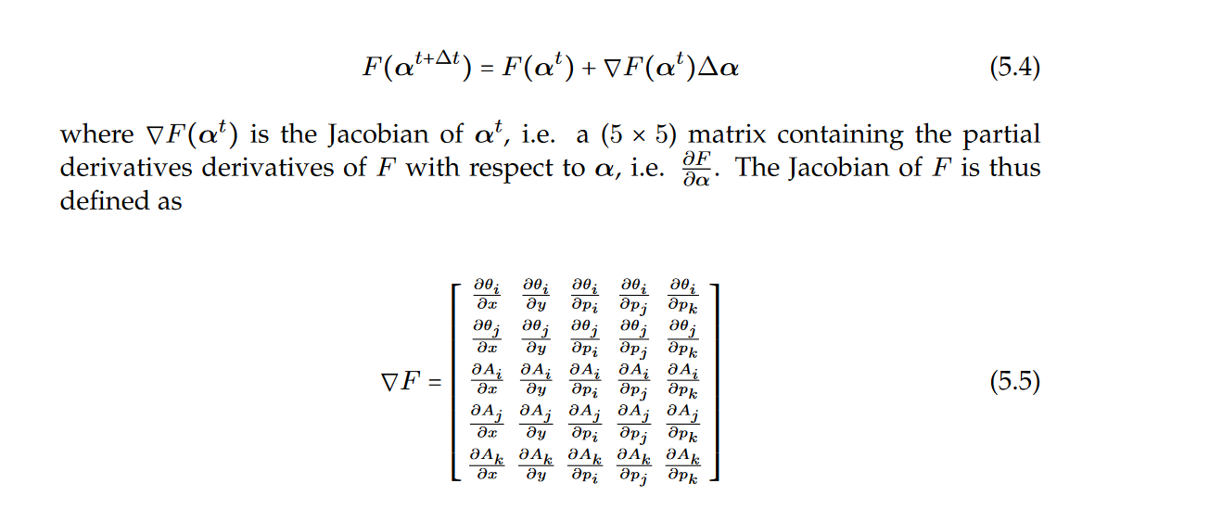

Finding the configuration for equilibrium state
Reduced to five parameters → 360 degree minus other two angles to get the third one
Parameters after $Δt$

Slide 16
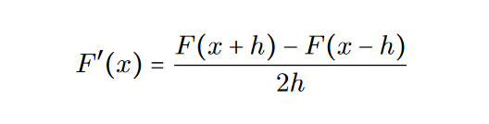
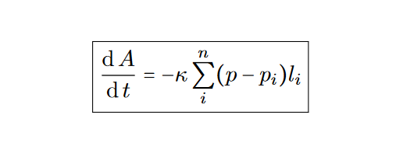
Finding the configuration for equilibrium state
Approximation of the partial derivatives using finite differences
Target area by integrating von Neumann’s equation
Current area

Slide 17
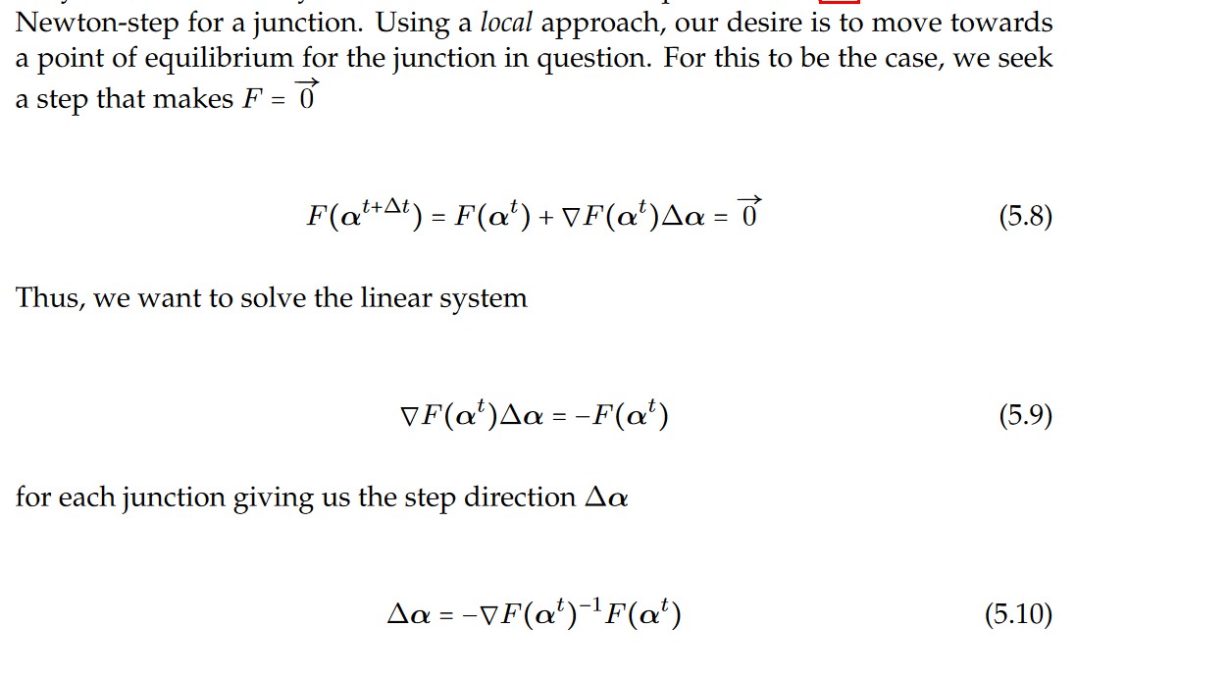
Approximation of integrals
With these technicalities in place, we can move on to solving the system. (5.3) states that the optimal solution at which a junction is in a state of equilibrium. If all junctions obey this, the whole system will be in a state of equilibrium.
Using a local approach, our desire is to move towards a point of equilibrium for the junction in question.

Slide 18
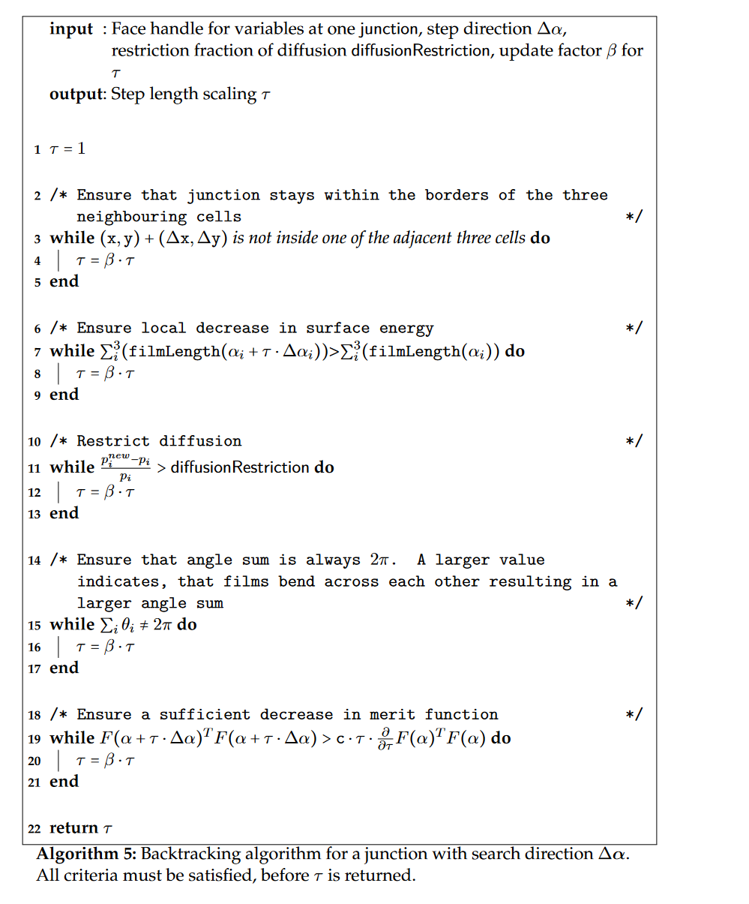

Peudocode for backtracking
Even if we are able to find a direction by solving for each k step, the step might be too far away and yields physically impossible result. This is why we need to backtracking to ensure that the step is physical real.

Slide 19
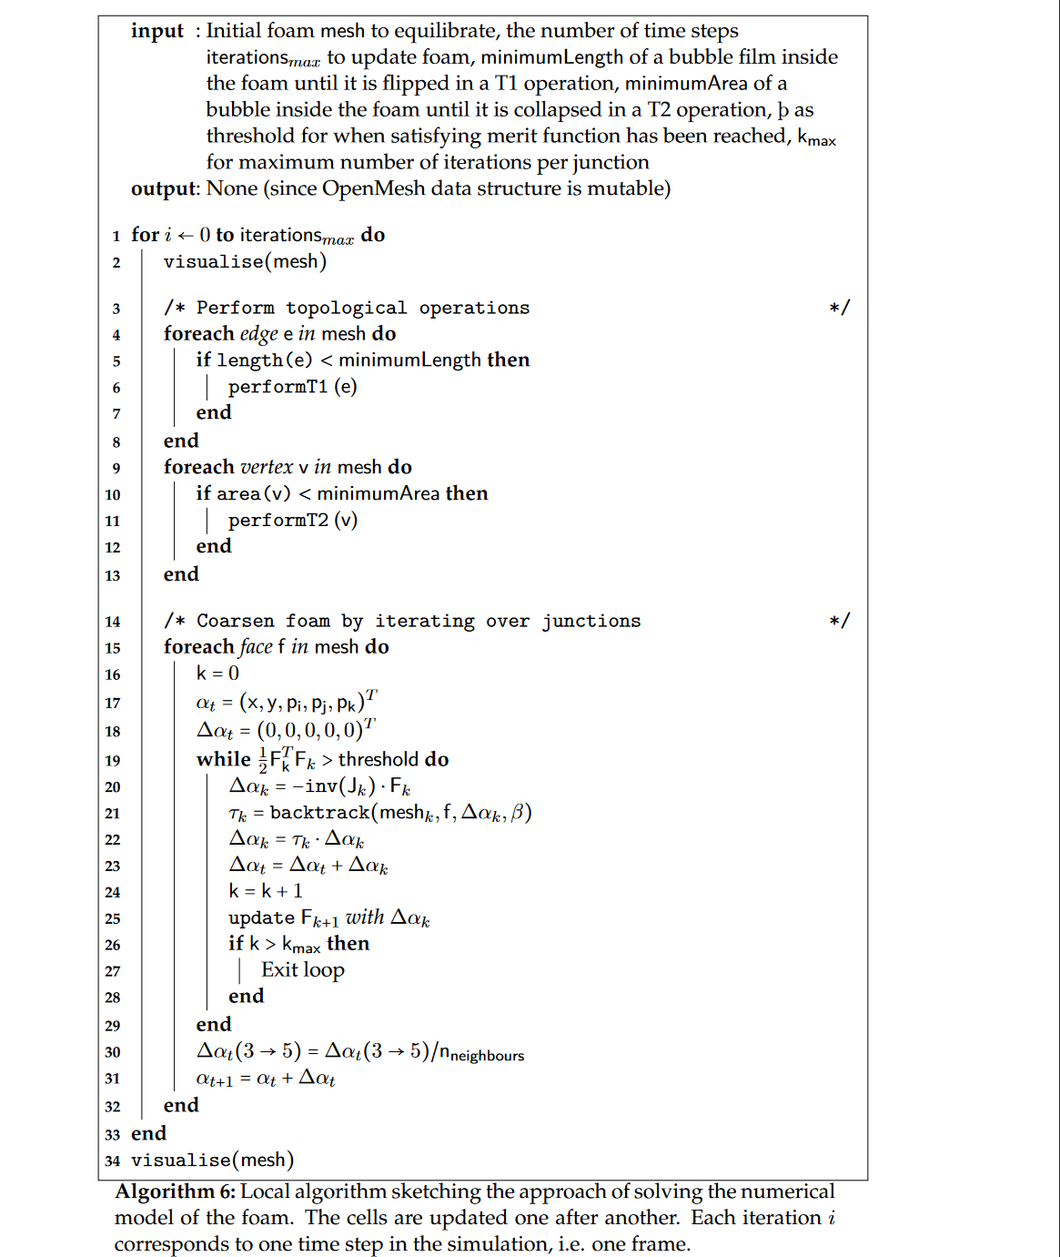
Peudocode for local relaxation
it is time frame
For each time frame, perform the topological operations after each local minimization
it is time frame
Minimization of energy for each junction by solving the local relaxation

Slide 20
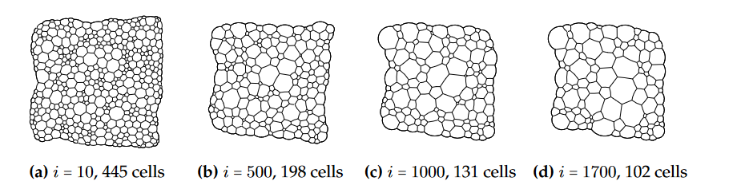
Result of local method:

Slide 21
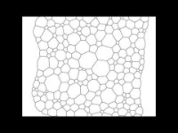
Result of local method:

